Slide 1
Gemmini Exploration Files
21/09/2022

Slide 2
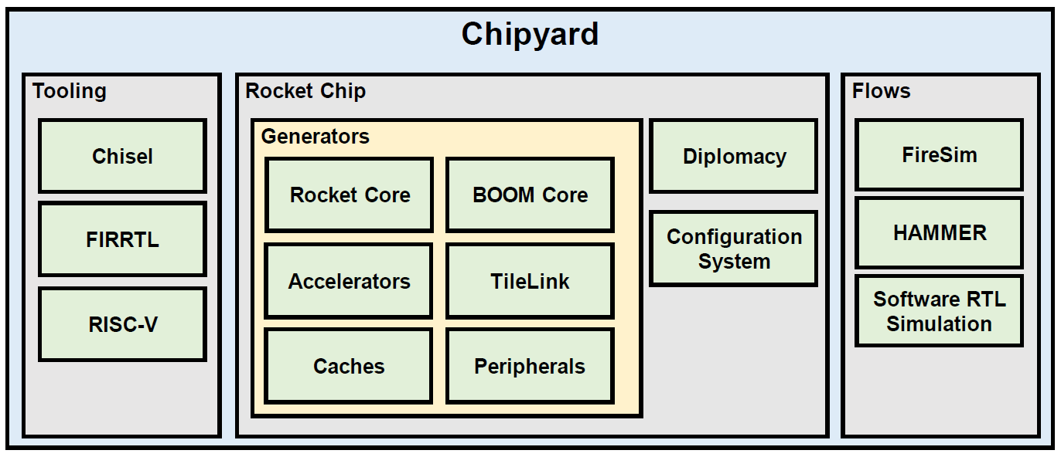
Environment
Chipyard is an open-source SoC development platform launched by UC Berkeley
Chipyard provides many components for building SoC around the RISC-V CPU and also provides many environments for testing and development
Among the components of Chipyard, the CPU based on the RISC-V instruction set includes: Rocket core, Berkeley Out-of-Order Machine (BOOM), CVA6, and Ibex core

Slide 3
Environment
In terms of hardware accelerators, Chipyard supports: Hwacha, Gemmini, SHA3 and NVDLA and other hardware accelerators with different purposes
System components including Icenet, Sifive-blocks, Analog Widget Library (AWL), testchipip, etc can be used during testing
These IPs are open-source and can be used at no additional cost

Slide 4
Environment
Development tools and toolchains provided include Constructing Hardware in a Scala Embedded Language (Chisel), A Flexible Intermediate Representation for RTL (FIRRTL), Bartools, Dsptools, Dromajo, riscv-tools, esp-tools, etc.

Slide 5
Environment
Simulators provided include Spike (RISC-V ISA Simulator), Verilator (open-source), VCS (license needed ), and the cloud-based FPGA simulation provided by the University of Berkeley Device (FireSim)
Chipyard also supports two VLSI design methods: FPGA Prototyping and ASIC

Slide 6
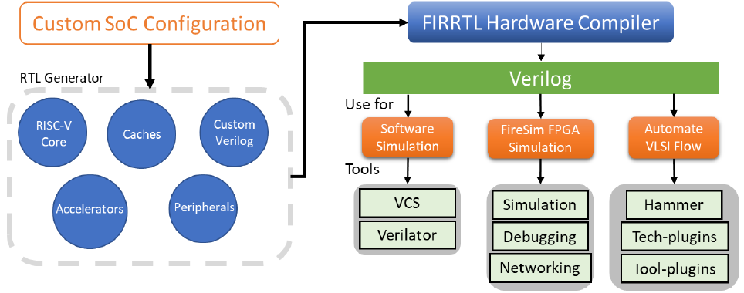
Chipyard Design Flow
Select the chipyard open-source CPU, the design expressed by Chisel, the external interface, the external devices, cache memory, AI hardware accelerator
After the hardware configuration the Chisel is replaced with Verilog through FIRRTL (a hardware compiler)
RTL simulation tools such as Verilator and VCS can be used for simulation or FPGA simulation can be run on the cloud system established by the University of Berkeley

Slide 7
Chisel
Chisel is an open-source high-level HDL embedded in Scala developed by the University of Berkeley
Chisel is mainly used to describe digital circuits in RTL and some highly parameterized circuits
Chisel adds the syntax of constructing hardware to Scala language, which provides hardware circuit designers with powerful functions similar to the current mainstream software programming languages such as Python, C, etc.
Through the hardware compiler, it can generate Synthetic Verilog circuit
The use of parameters makes the design more intuitive and easy
The University of Berkeley used Chisel to design a CPU based on the RISC-V instruction set
To put it simply, Chisel can be understood as a Verilog generator (requires the hardware compiler FIRRTL), which can quickly and efficiently develop hardware designs by using Scala syntax

Slide 8
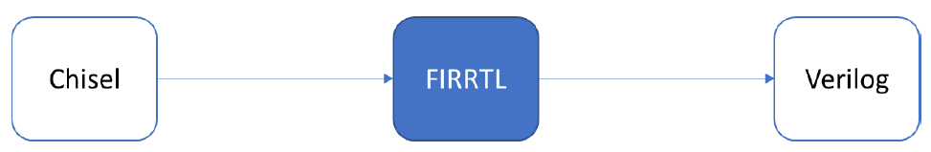
FIRRTL
FIRRTL is a hardware compiler based on Chisel: Its main function is to compile Chisel into Verilog
When FIRRTL works as a hardware compiler, it will optimize the circuit through algorithms, resource sharing, reuse of specific modules, and reduction of unnecessary registers, etc.
It will also report syntax error of the Chisel code
FIRRTL also supports adding specific rules or conditions in the hardware compiler, so that FIRRTL can better meet the circuit conversion mode needed

Slide 9
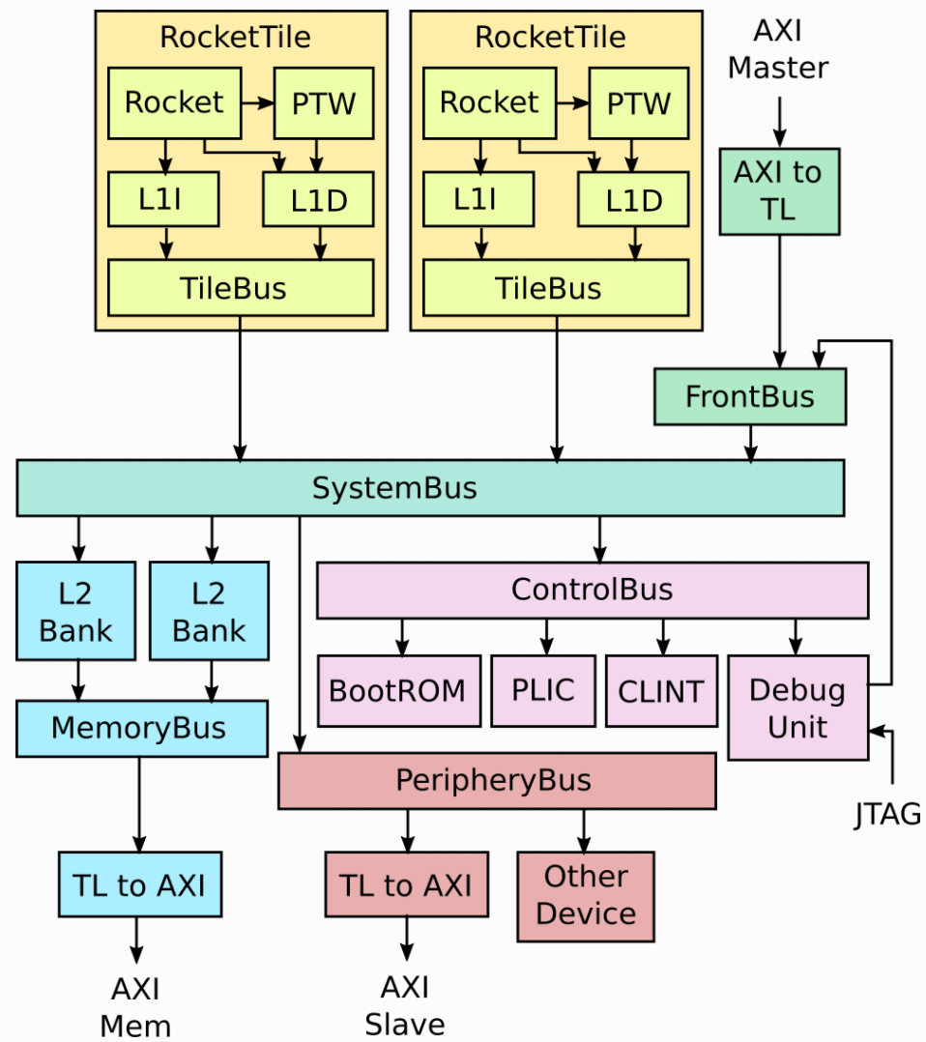
Rocketchip Generator
Tiles: unit of replication for a core
CPU
L1 Caches
Page Table Walker (PTW)
L2 banks
Receive memory requests
FrontBus
Connects to DMA devices
ControlBus
Connects to core complex devices
PeripheryBus
Connects to other devices
SystemBus
Ties everything together

Slide 10
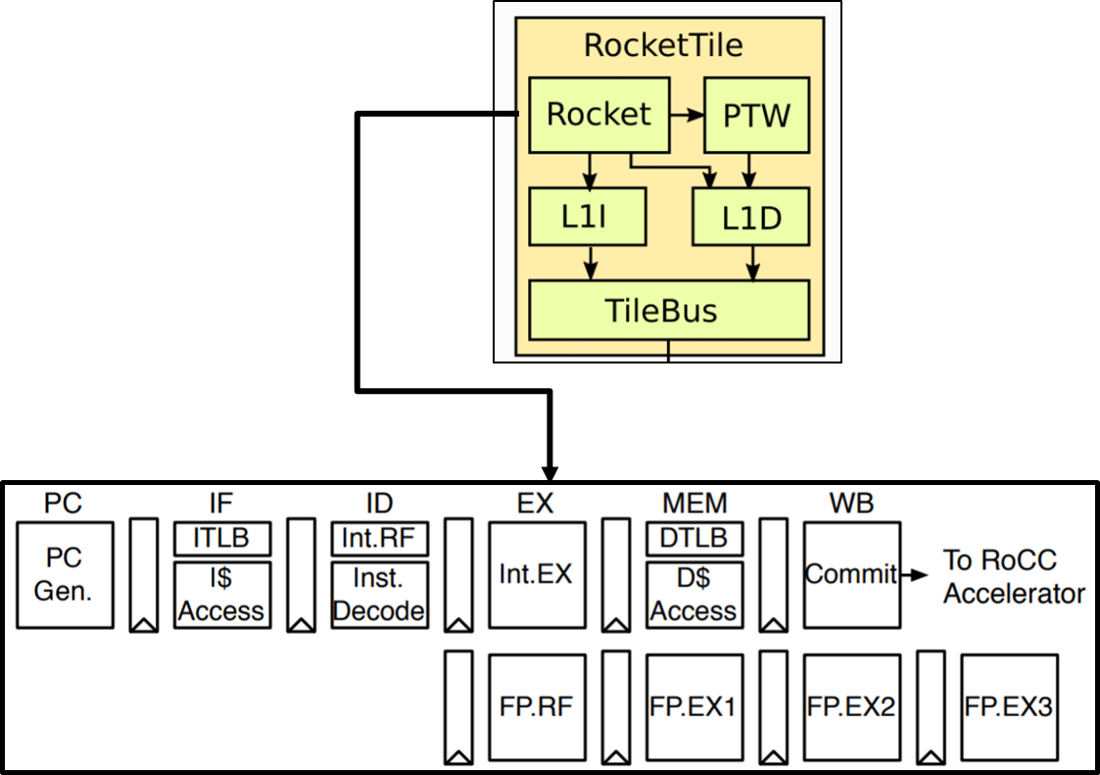
Rocket Core
Each Rocket core is grouped with:
A page-table walker
L1 instruction cache
L1 data cache
The Rocket core
First open-source RISC-V CPU
In order, single issue RV64GC core
64-bit 5-stage single-issue in-order pipeline
Design minimizes impact of long clock-to-output delays of compiler-generated RAMs

Slide 11
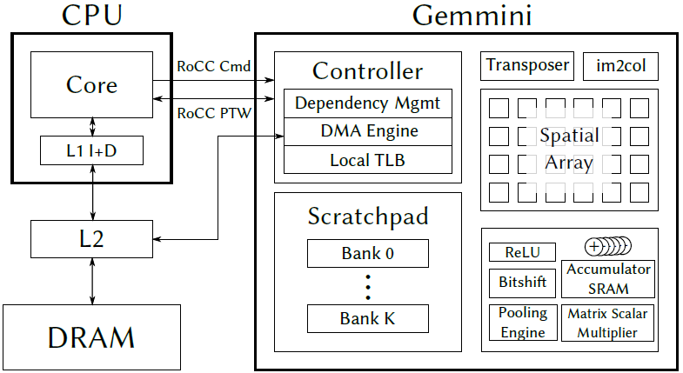
Gemmini Framework Analysis
The core of the Gemmini accelerator is a circuit composed of a Systolic Array that performs matrix multiplication, and is also a part of the Chipyard ecosystem
Gemmini is implemented through the Chisel HDL
The circuit can realize the acceleration of matrix multiplication, convolution operation and other operations that require a lot of CPU resources in the form of data flow
Currently, the data flow methods supported by Gemmini include Weight Stationary (WS) and Output Stationary (OS)

Slide 12
Gemmini Framework Analysis
Gemmini is a Rocket Custom Coprocessor Interface (RoCC) accelerator using RISC-V custom instructions
Using Rocket or BOOM core, the RoCC interface issue instruction to and from Gemmini
A Direct Memory Access (DMA) controller to move the data to and from Gemmini
Gemmini hardware supports: DMA Controller, Scratchpad, Activation Function Unit, Scaling Function Unit, Transposer, Systolic Array etc.

Slide 13
Installing Chipyard and Gemmini Tools
Run the steps to install Chipyard and Gemmini tools
$ git clone https://github.com/ucb-bar/chipyard.git
$ cd chipyard
$ git checkout 117624d8eea27bafd613eec09e9b9b3e31239e08
$ ./scripts/init-submodules-no-riscv-tools.sh
$ ./scripts/build-toolchains.sh esp-tools
$ source env.sh
$ cd generators/gemmini
$ git fetch && git checkout v0.6.4
$ git submodule update
$ cd -
$ cd toolchains/esp-tools/riscv-isa-sim/build
$ git fetch && git checkout 090e82c473fd28b4eb2011ffcd771ead6076faab
$ make && make install

Slide 14
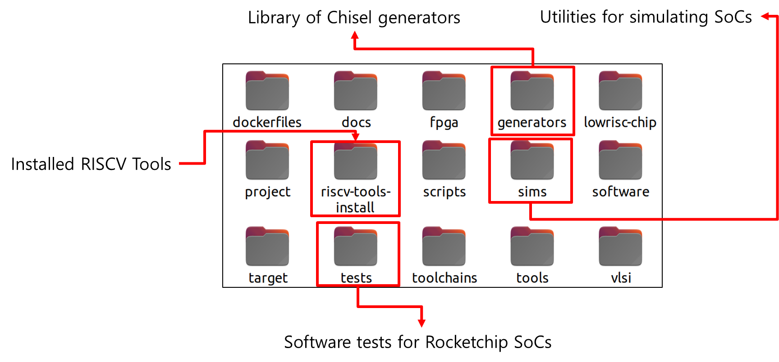
Installing Chipyard and Gemmini Tools
Inside the Chipyard directory

Slide 15
Workflow
This work explored the effects of several configuration parameters of the Gemmini accelerator on both performance and hardware resource utilization by using a development framework that is made up of a combination of both open-source and proprietary tools
The flow is organized into three interconnected categories which include
The Gemmini SoC RTL code Generation Flow
The Software Code Compilation Flow
Gemmini RTL Code Synthesis Flow

Slide 16
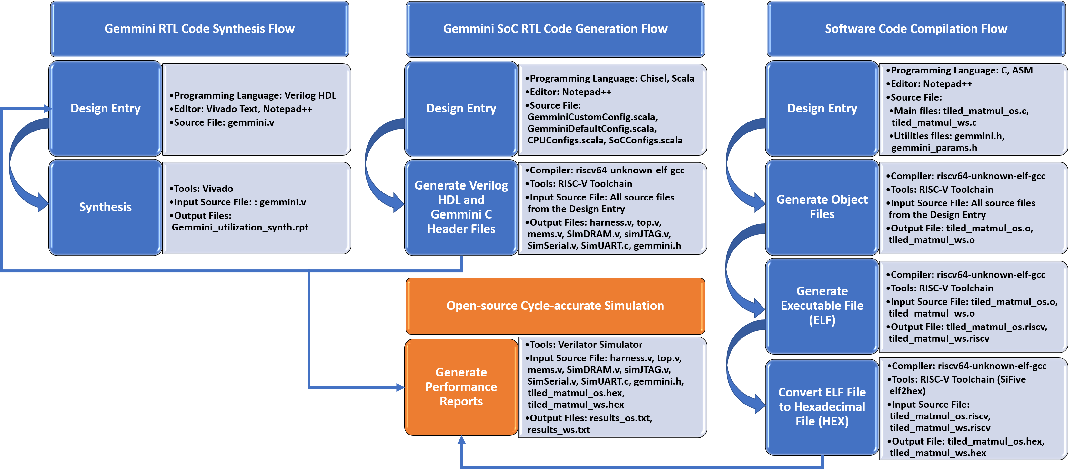
Workflow
This section details the workflows giving the steps involved and the tools used in each step

Slide 17
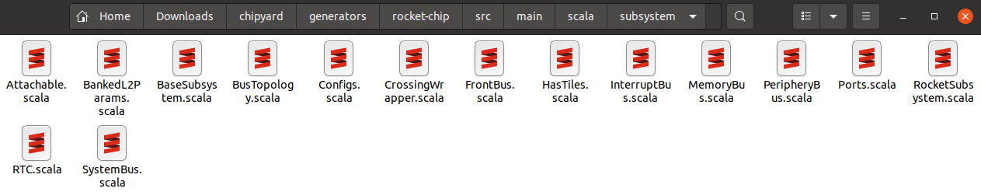
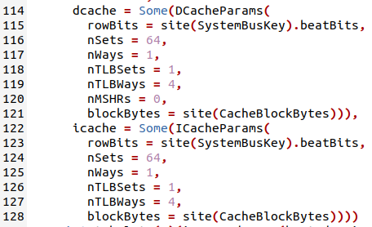
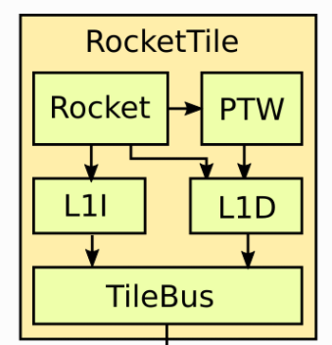
SoC RTL Generation (L1Cache)
Config file location

Slide 18
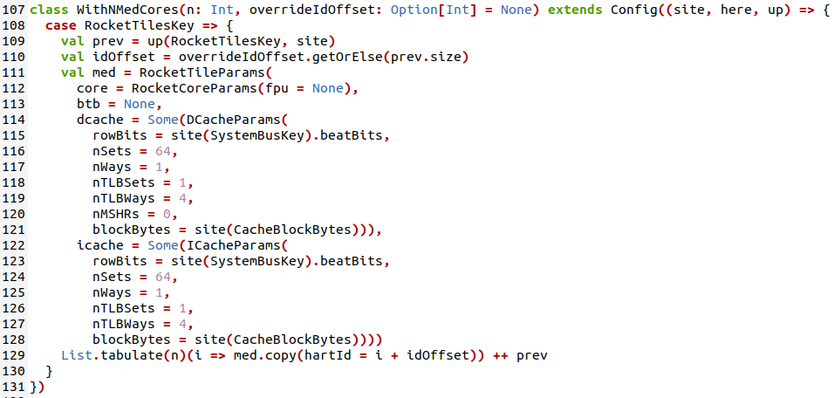
SoC RTL Generation (Rocket Core)
Config file location

Slide 19
SoC RTL Generation (Rocket Core)
Config file location
Different Rocket cores
Config | Big Core | Med Core | Small Core | Tiny Core
Datawidth | 64 | 64 | 64 | 32
FPU | Available | None | None | None
Instruction Cache | 16KB | 4KB | 4KB | 4KB
Data Cache | 16KB | 4KB | 4KB | 4KB
Cache Mapping | 4-way Set Associative | Direct Mapping | Direct Mapping | Direct Mapping

Slide 20
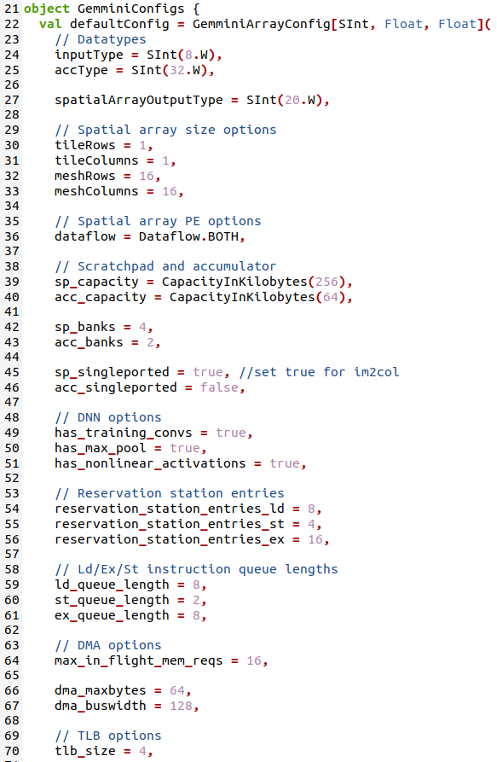
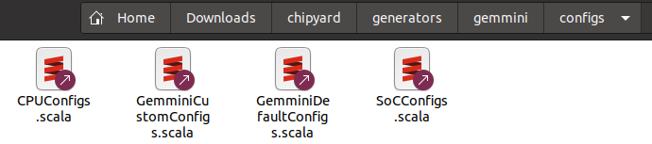
SoC RTL Generation (Gemmini)
Config file location

Slide 21
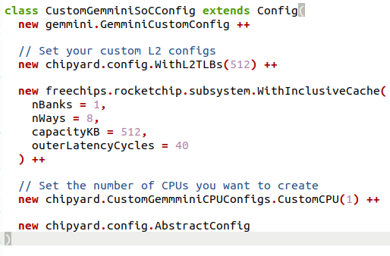
SoC RTL Generation (Gemmini)
Config file location

Slide 22
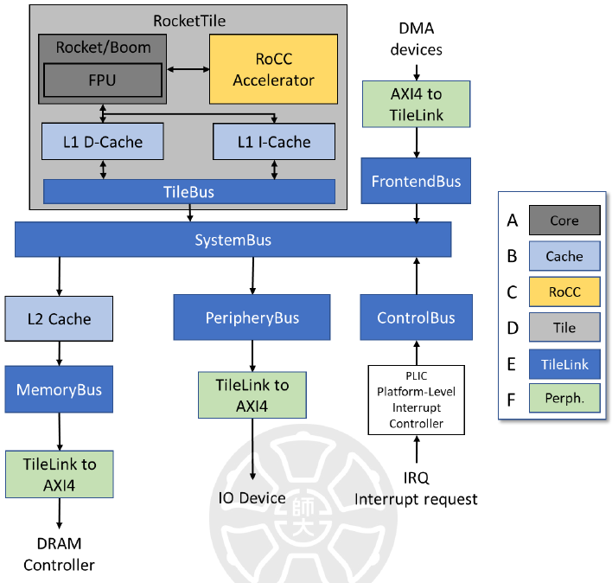
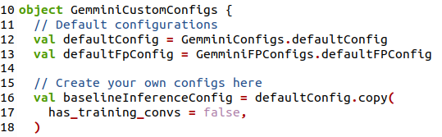
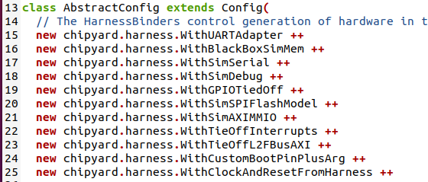
SoC RTL Generation (Gemmini)
Config file location

Slide 23
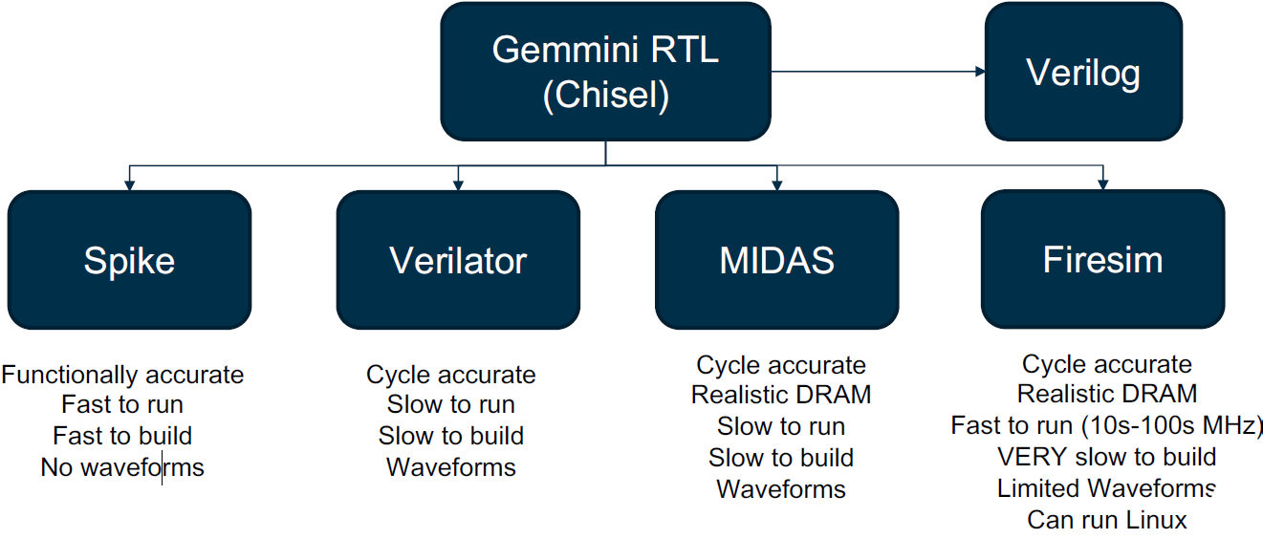
Gemmini Build Outputs
Gemmini build outputs

Slide 24
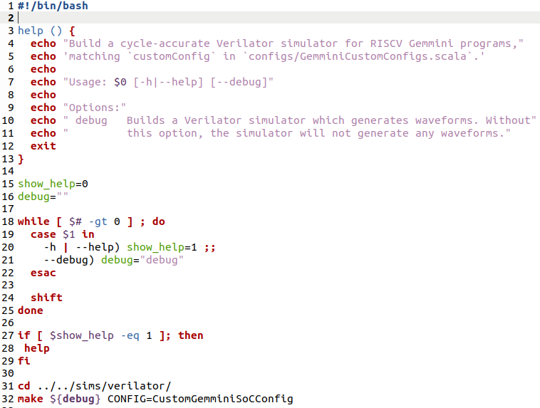
Gemmini Hardware/Cycle-Accurate Simulators
Run the instructions below to build a cycle-accurate Gemmini simulator using Verilator
cd chipyard/generators/gemmini
./scripts/build-verilator.sh
After running this, in addition to the cycle-accurate simulator, you will be able to find the Verilog description of your SoC in generated-src/

Slide 25
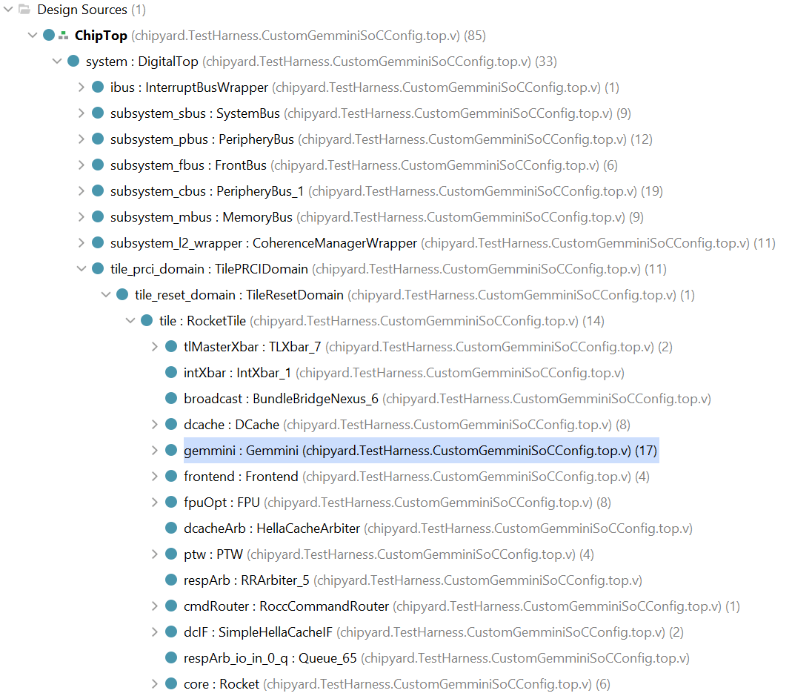
View Generated Verilog
Some Generated Verilog files for Gemmini SoC

Slide 26
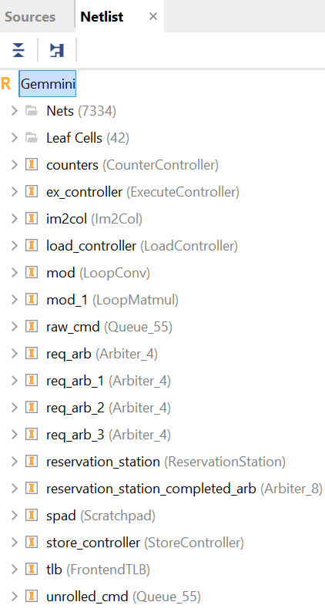
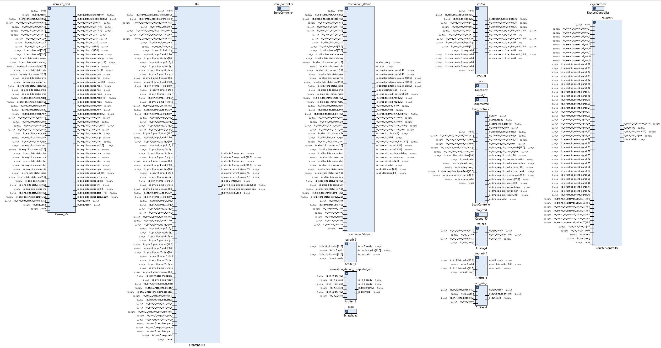
View Generated Verilog
Modules inside Gemmini

Slide 27
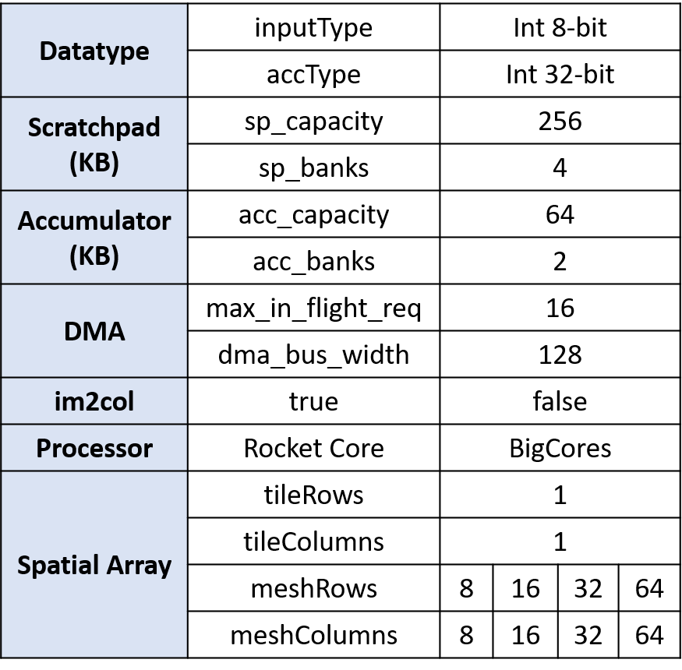
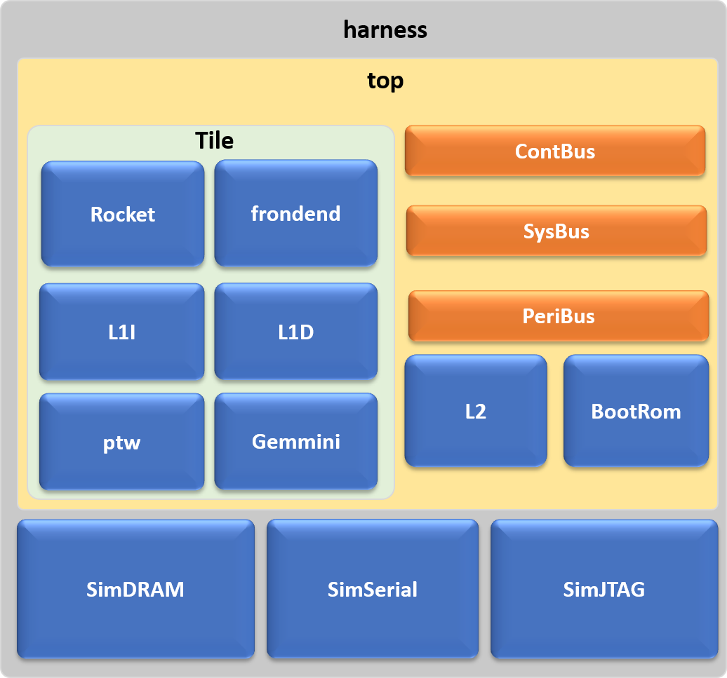
Configuration Parameters
The figure illustrates the configuration parameters selected for generating the Gemmini accelerators for this work and the overall architecture for simulating the Gemmini SoC

Slide 28
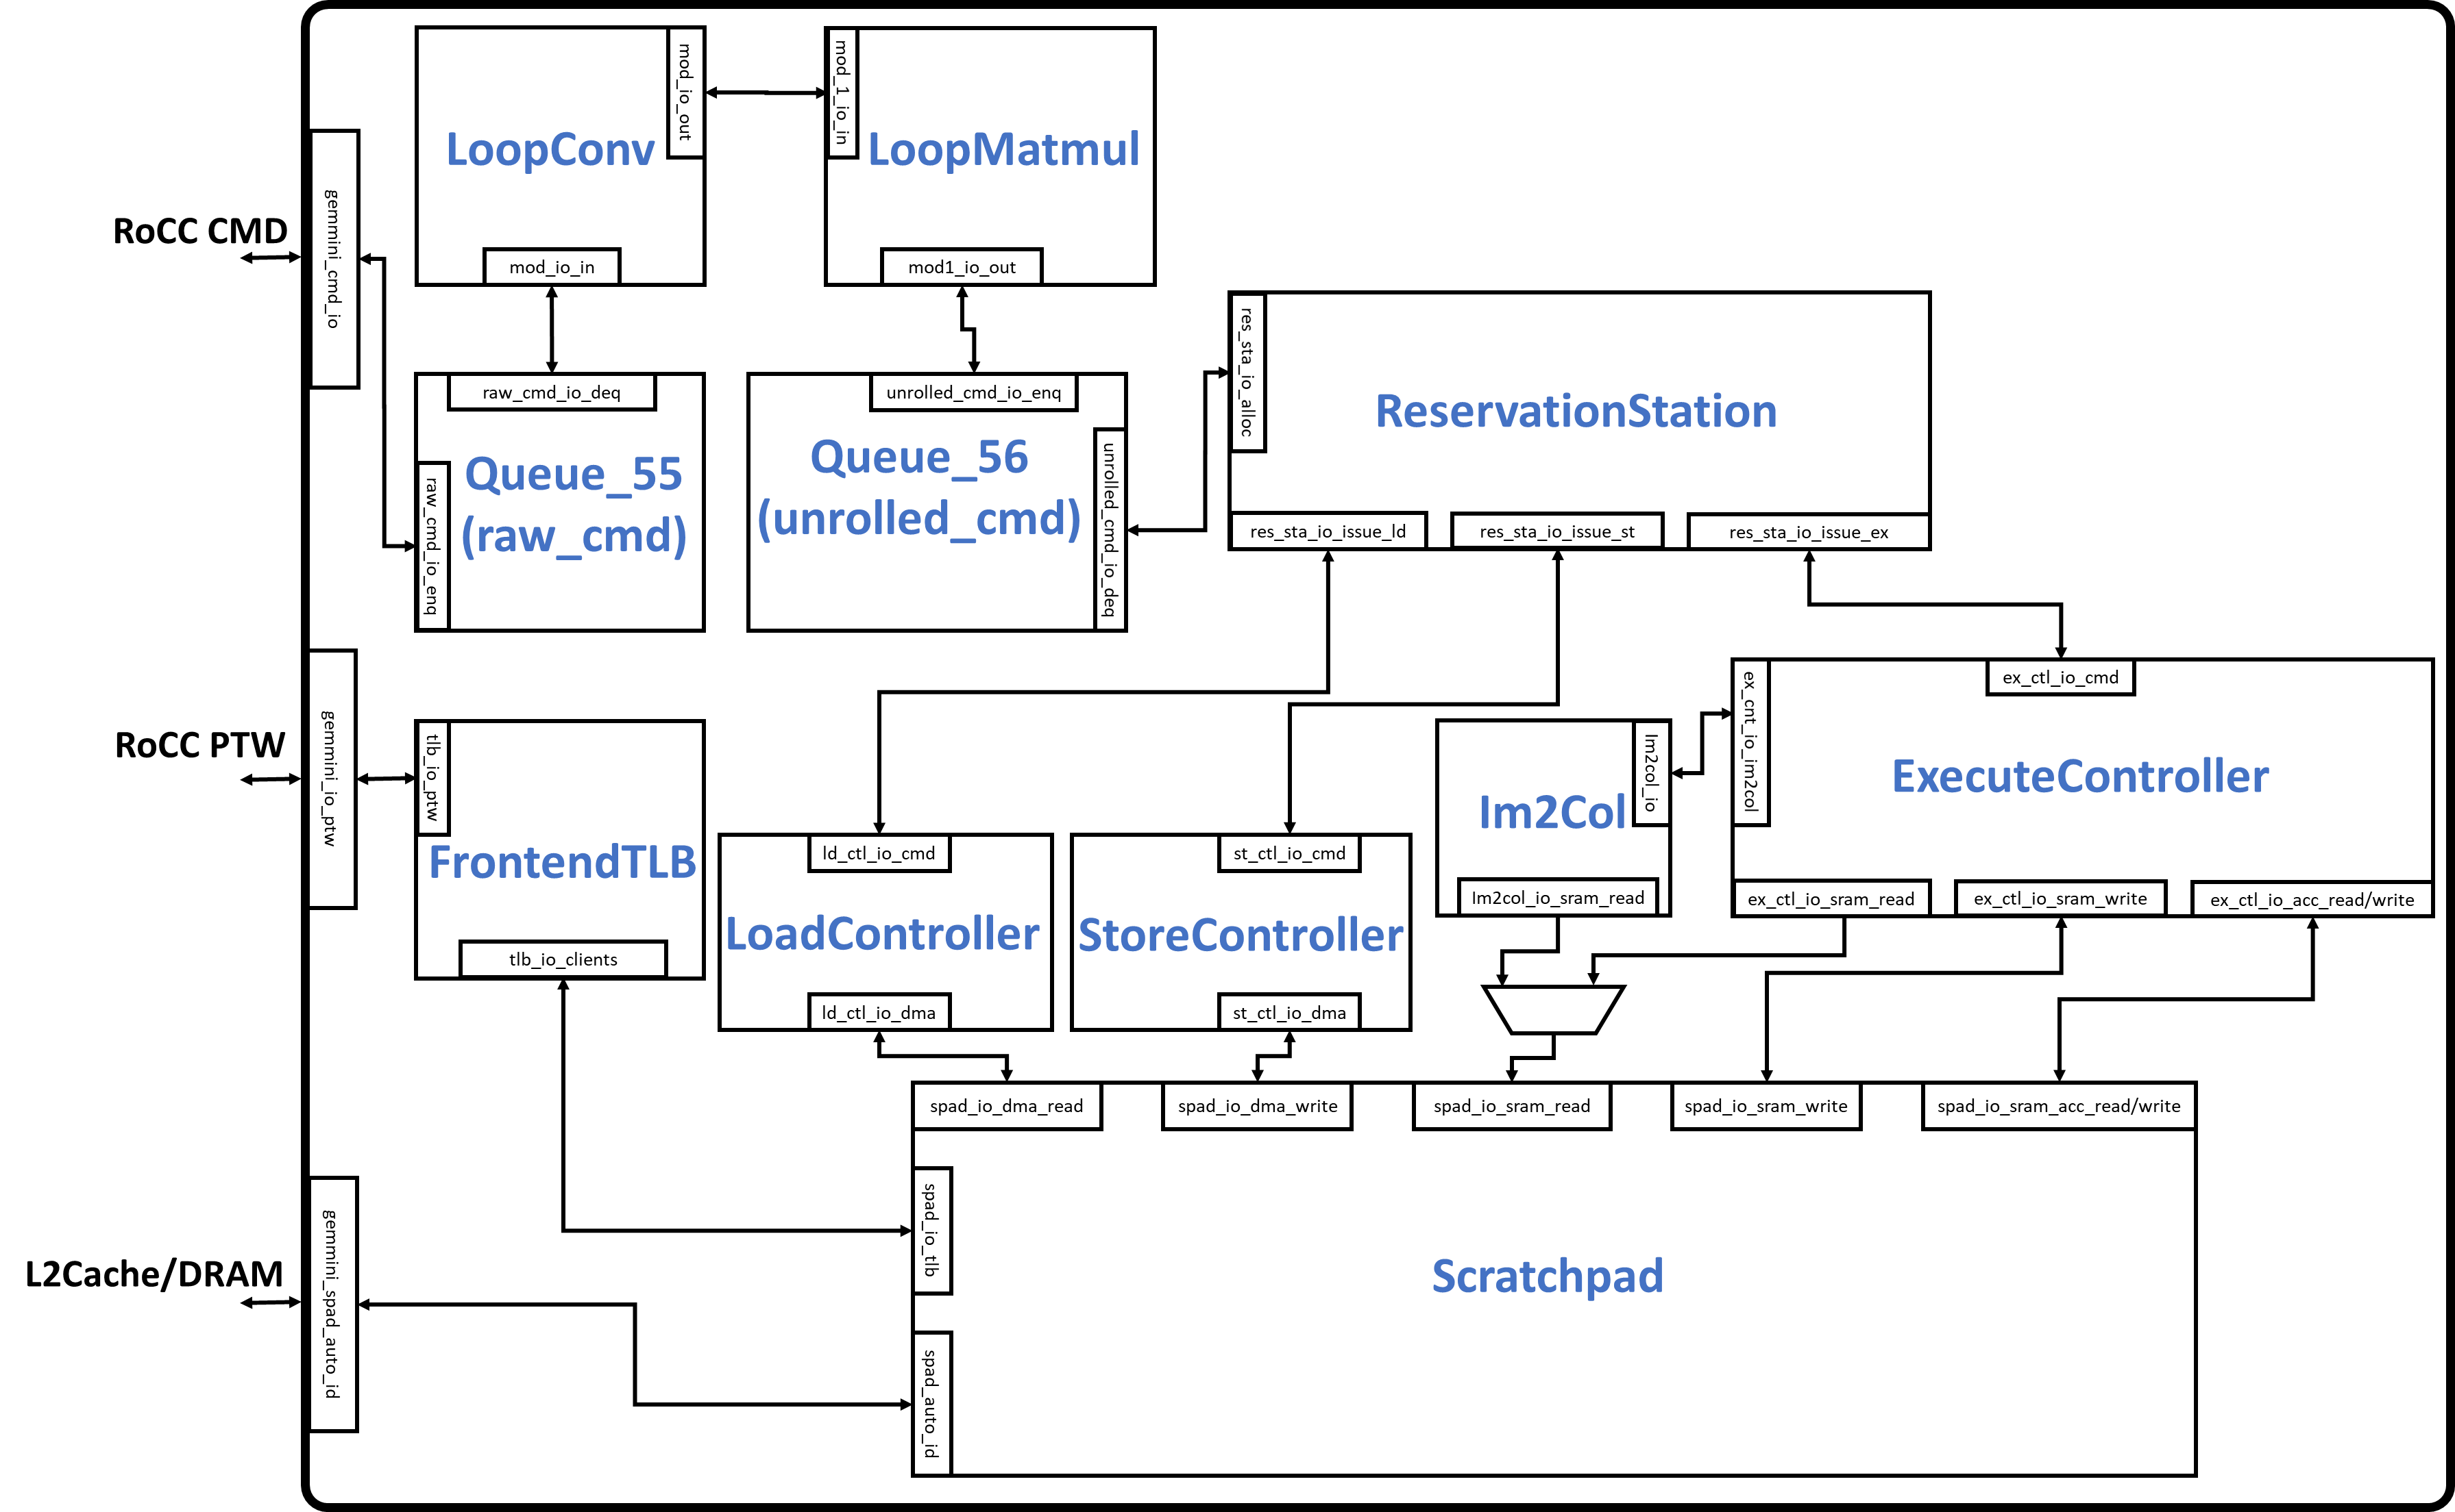
Gemmini Modules (Overall)
Gemmini Modules

Slide 29
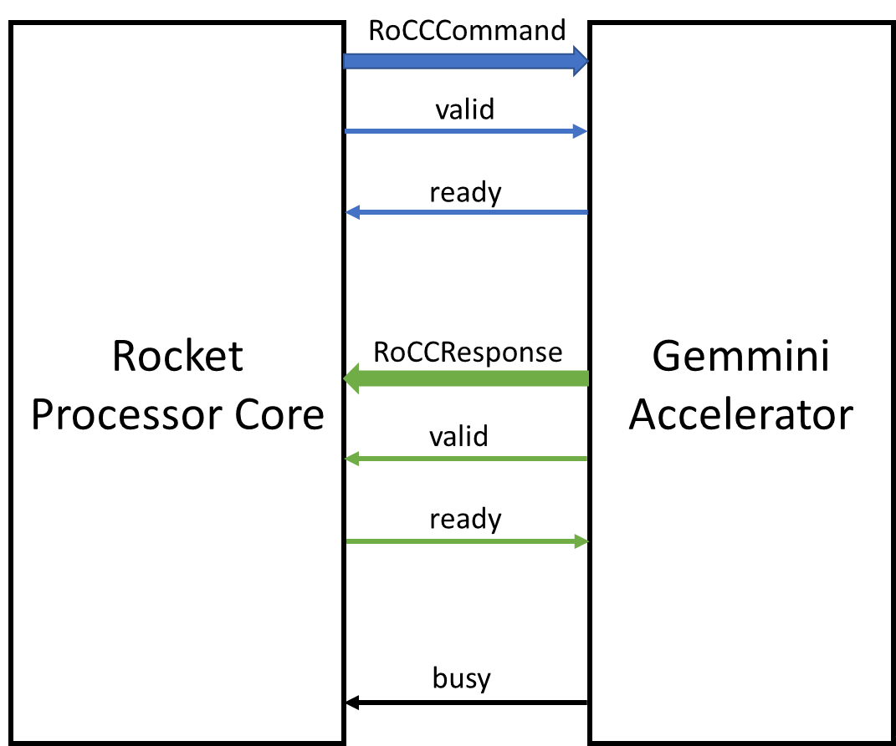
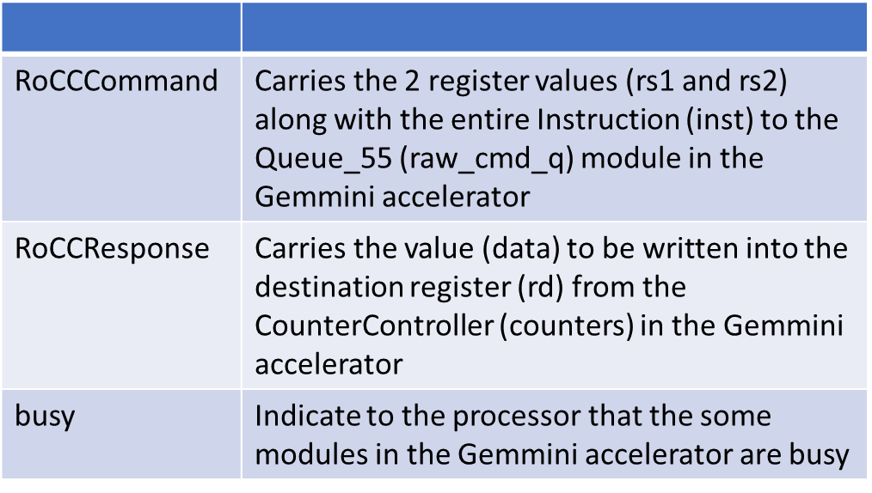
The RoCC Interface
The Rocket Custom Coprocessor (RoCC) Interface

Slide 30
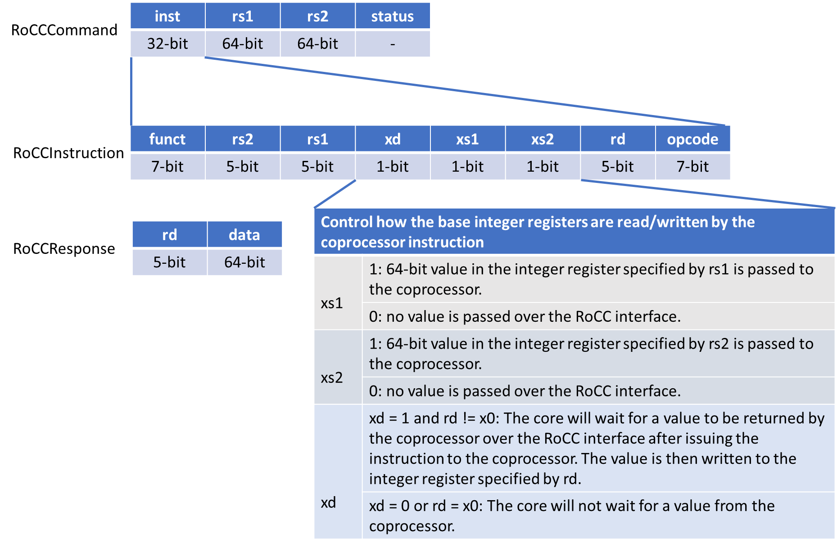
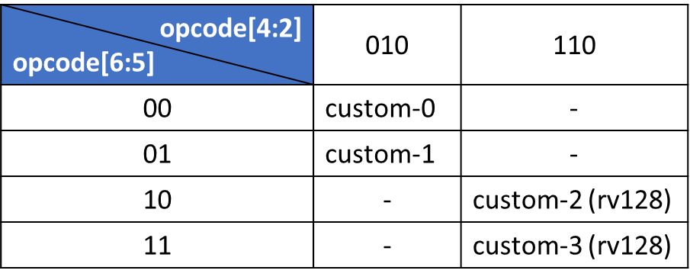
RoCC Instruction Format
RoCC instruction format

Slide 31
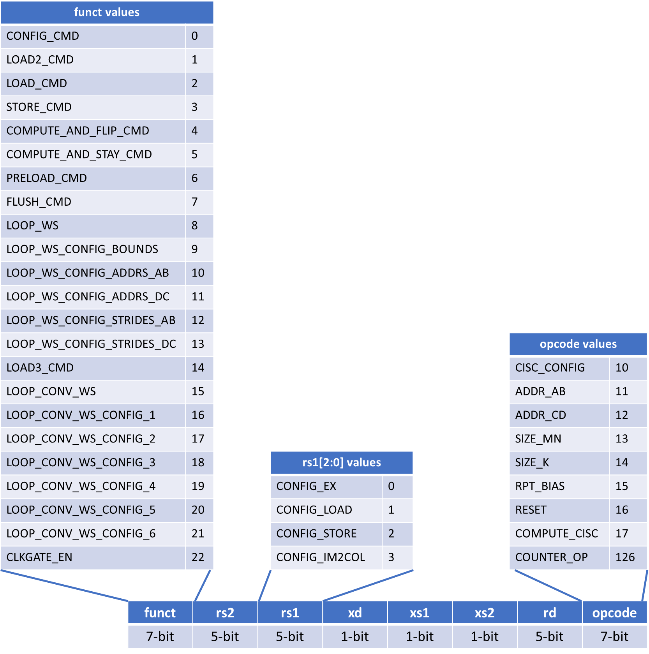
Gemmini Assembly-level ISA
Gemmini assembly-level ISA

Slide 32
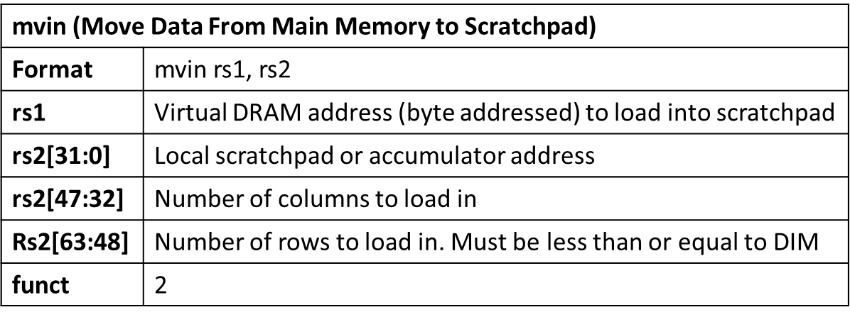
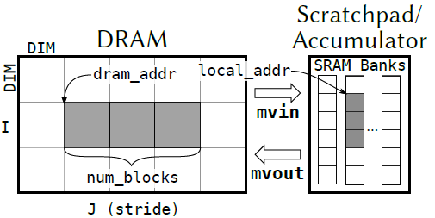
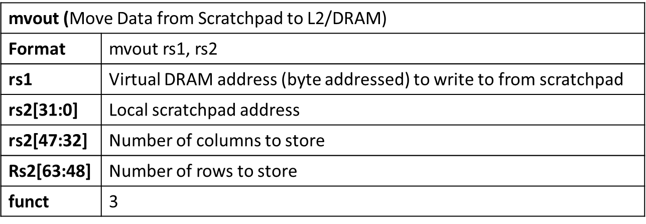
Gemmini Assembly-level ISA
Data movement

Slide 33
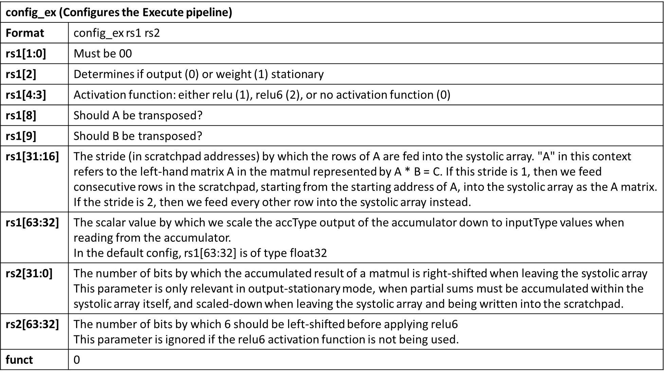
Gemmini Assembly-level ISA
Configuration

Slide 34
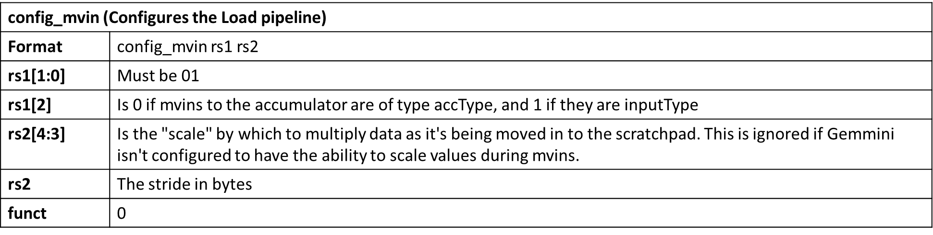
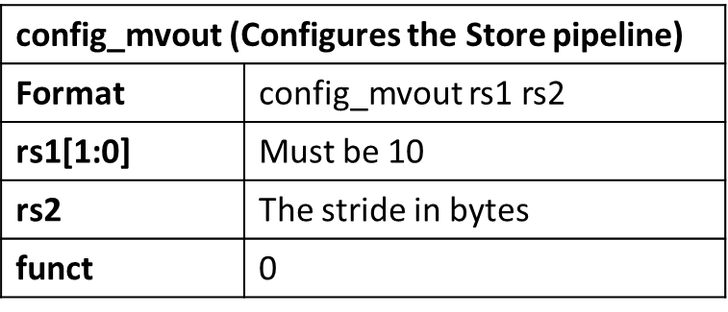
Gemmini Assembly-level ISA
Configuration

Slide 35
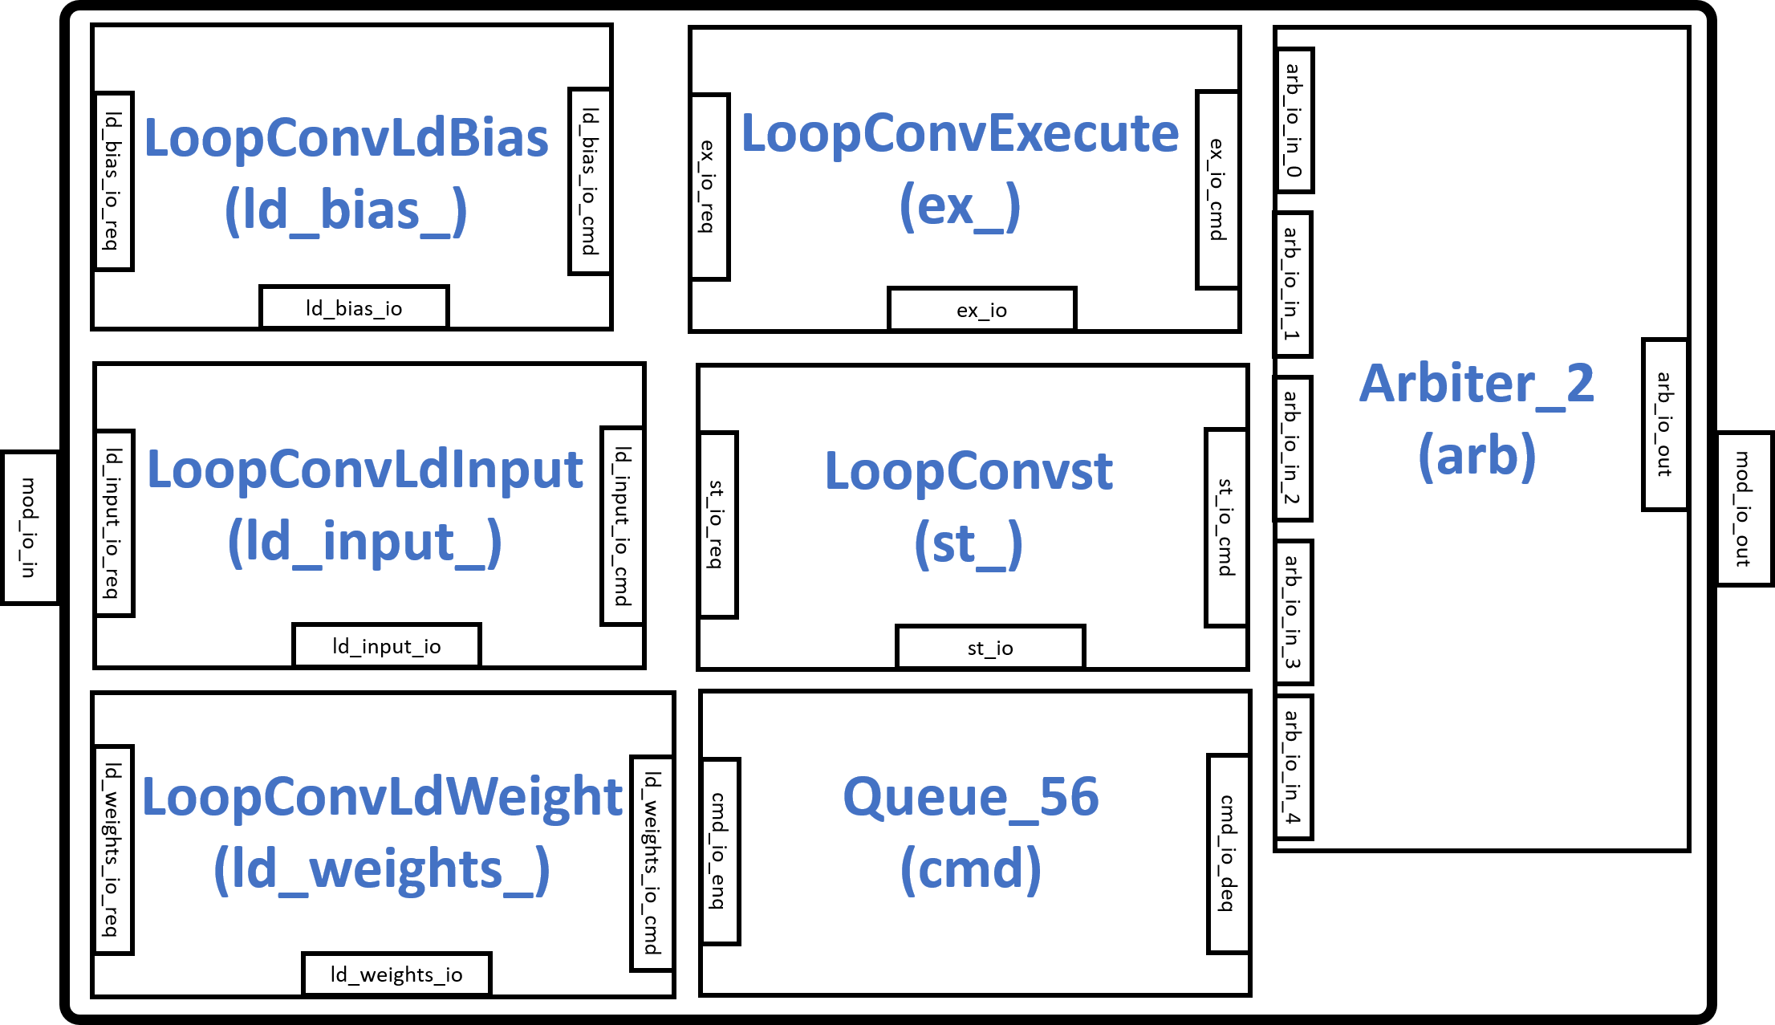
Gemmini Modules (LoopConv)
The LoopConv module is responsible for unrolling large convolutions to fit the systolic dimension of DIM×DIM
It consists of modules such as LoopConvLdBias, LoopConvLdWeight, and LoopConvLdInput for signifying instructions for the convolution operation bias, weight, and input respectively
The LoopConvExecute and LoopConvst module are instructions for executing the convolution operation and storing results respectively

Slide 36
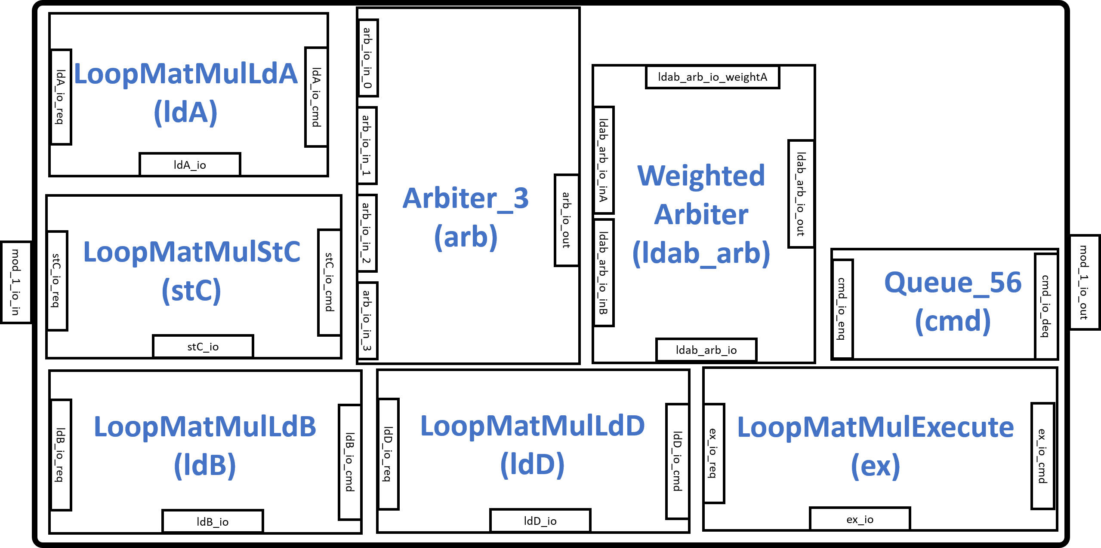
Gemmini Modules (LoopMatmul)
The LoopMatmul module is responsible for unrolling large matrix multiplications (matmuls) to fit the systolic dimension of DIM×DIM
In the module the LoopMatmulLdA, LoopMat-mulLdB, and LoopMatmulLdD specify the loading of matrix A, B, and D respectively while the LoopMatmulExecute module generates commands for the matrix multiplication
The LoopMatmulStC generates commands for storing the results of matrix C

Slide 37
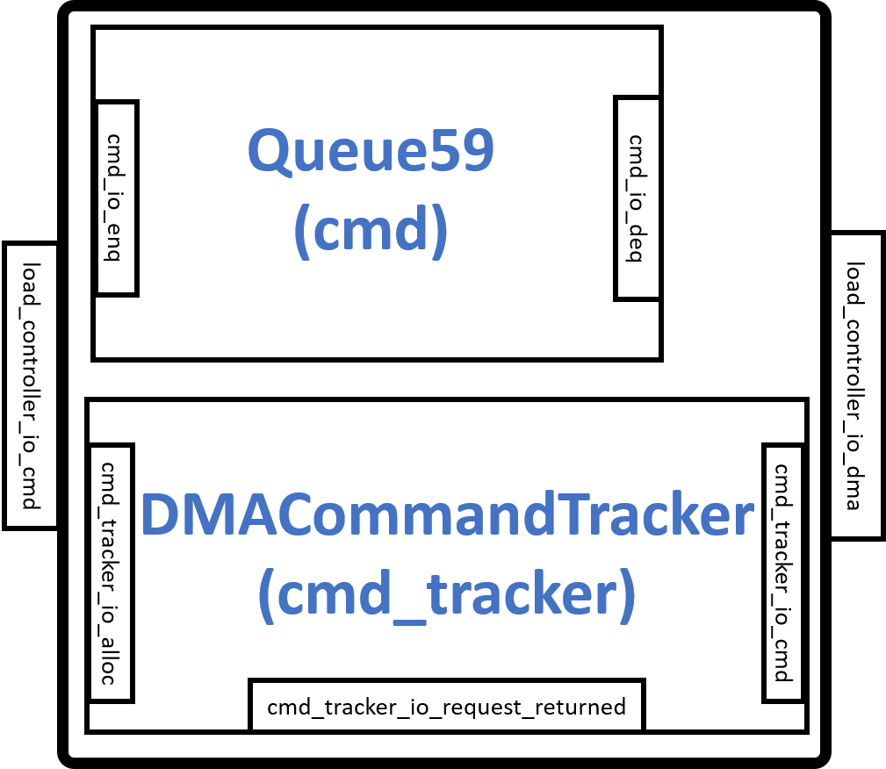
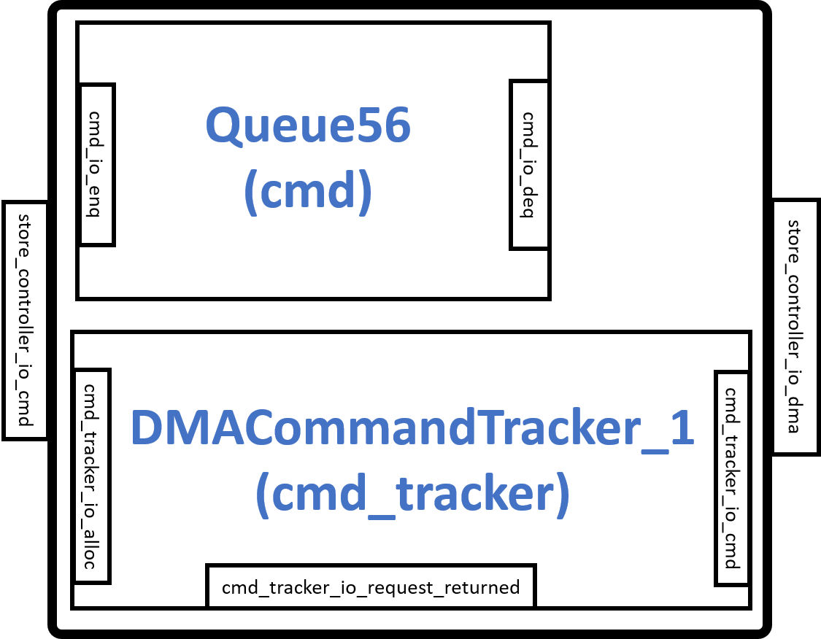
Gemmini Modules (Load/Store Controller)
The LoadController and StoreController are similar in design and are responsible for instructions that move data from the DRAM to the Gemmini Scratchpad and from Scratchpad to the DRAM respectively
The LoadController connects to the scratchpad DMA read interface while the StoreController connects to the scratchpad DMA write interface
Both controllers use a Finite State Machine (FSM) with three states including waiting_for_cmd, sending_rows, and waiting_for_dma_req_ready states for controlling their running modes

Slide 38
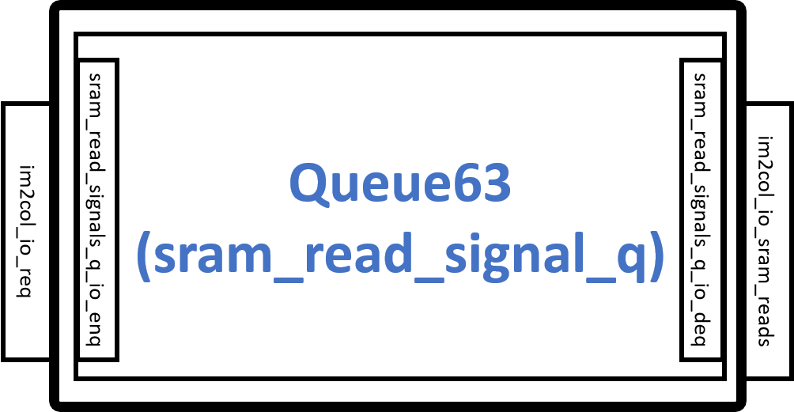
Gemmini Modules (im2col)
When the Gemmini accelerator is configured to have an im2col module, the interface connects and receives instructions from the ExecuteController module and also reads data from the SRAM read interface of the scratchpad module
The read data is then fed to the ExecuteController module
The im2col module is an address generator that uses an FSM to make sure that the PEs inside the systolic array of the ExecuteController are used as much as possible
The states in the im2col FSM include nothing_to_do, waiting_for_im2col, preparing_im2col, and im2col_done

Slide 39
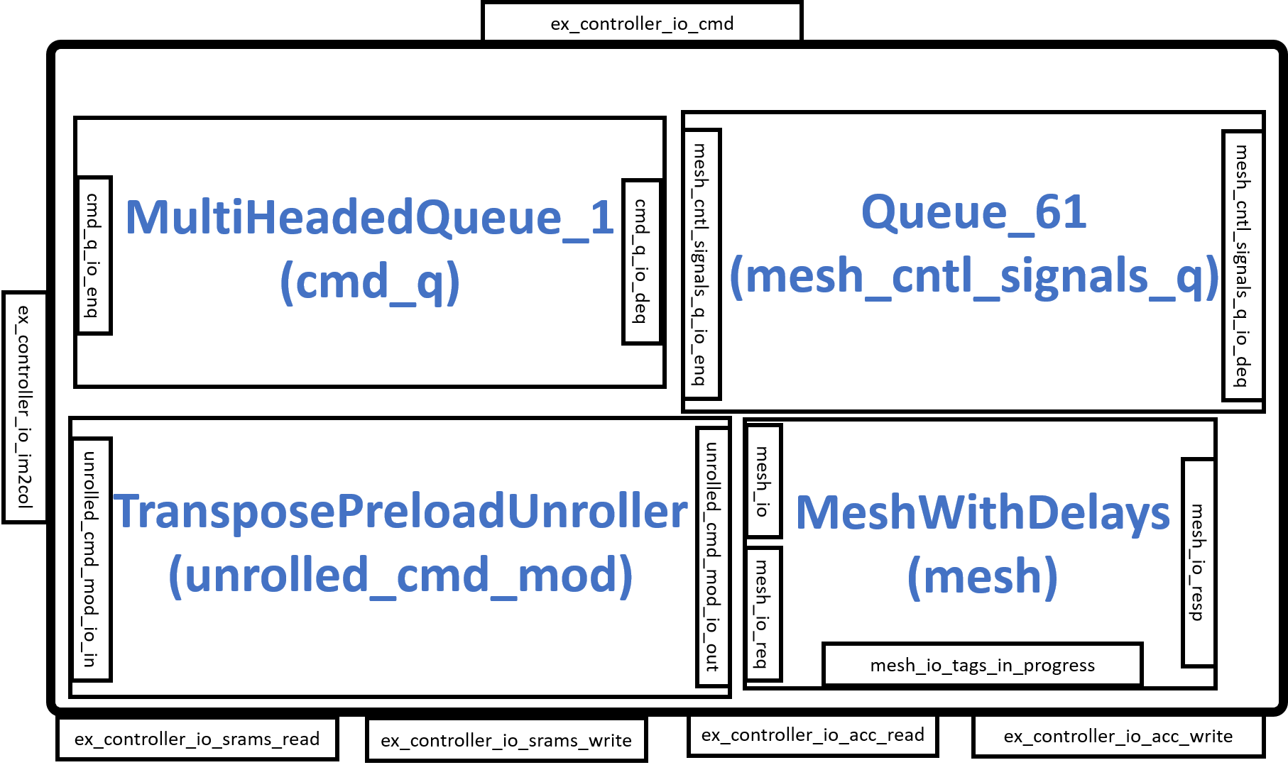
Gemmini Modules (ExecuteController)
The controller connects to the im2col interface and SRAM interfaces of the scratchpad
The MultiHeadedQueue_1 module is a buffer that separates the instructions into commands for the Scratchpad module and the MeshWithDelays module
The instructions or commands for the scratchpad module are sent to extract data from the SRAMs
The commands for the MeshWithDelays are first buffered in the Queue_61 module before being sent to control the systolic array and other components in the module

Slide 40
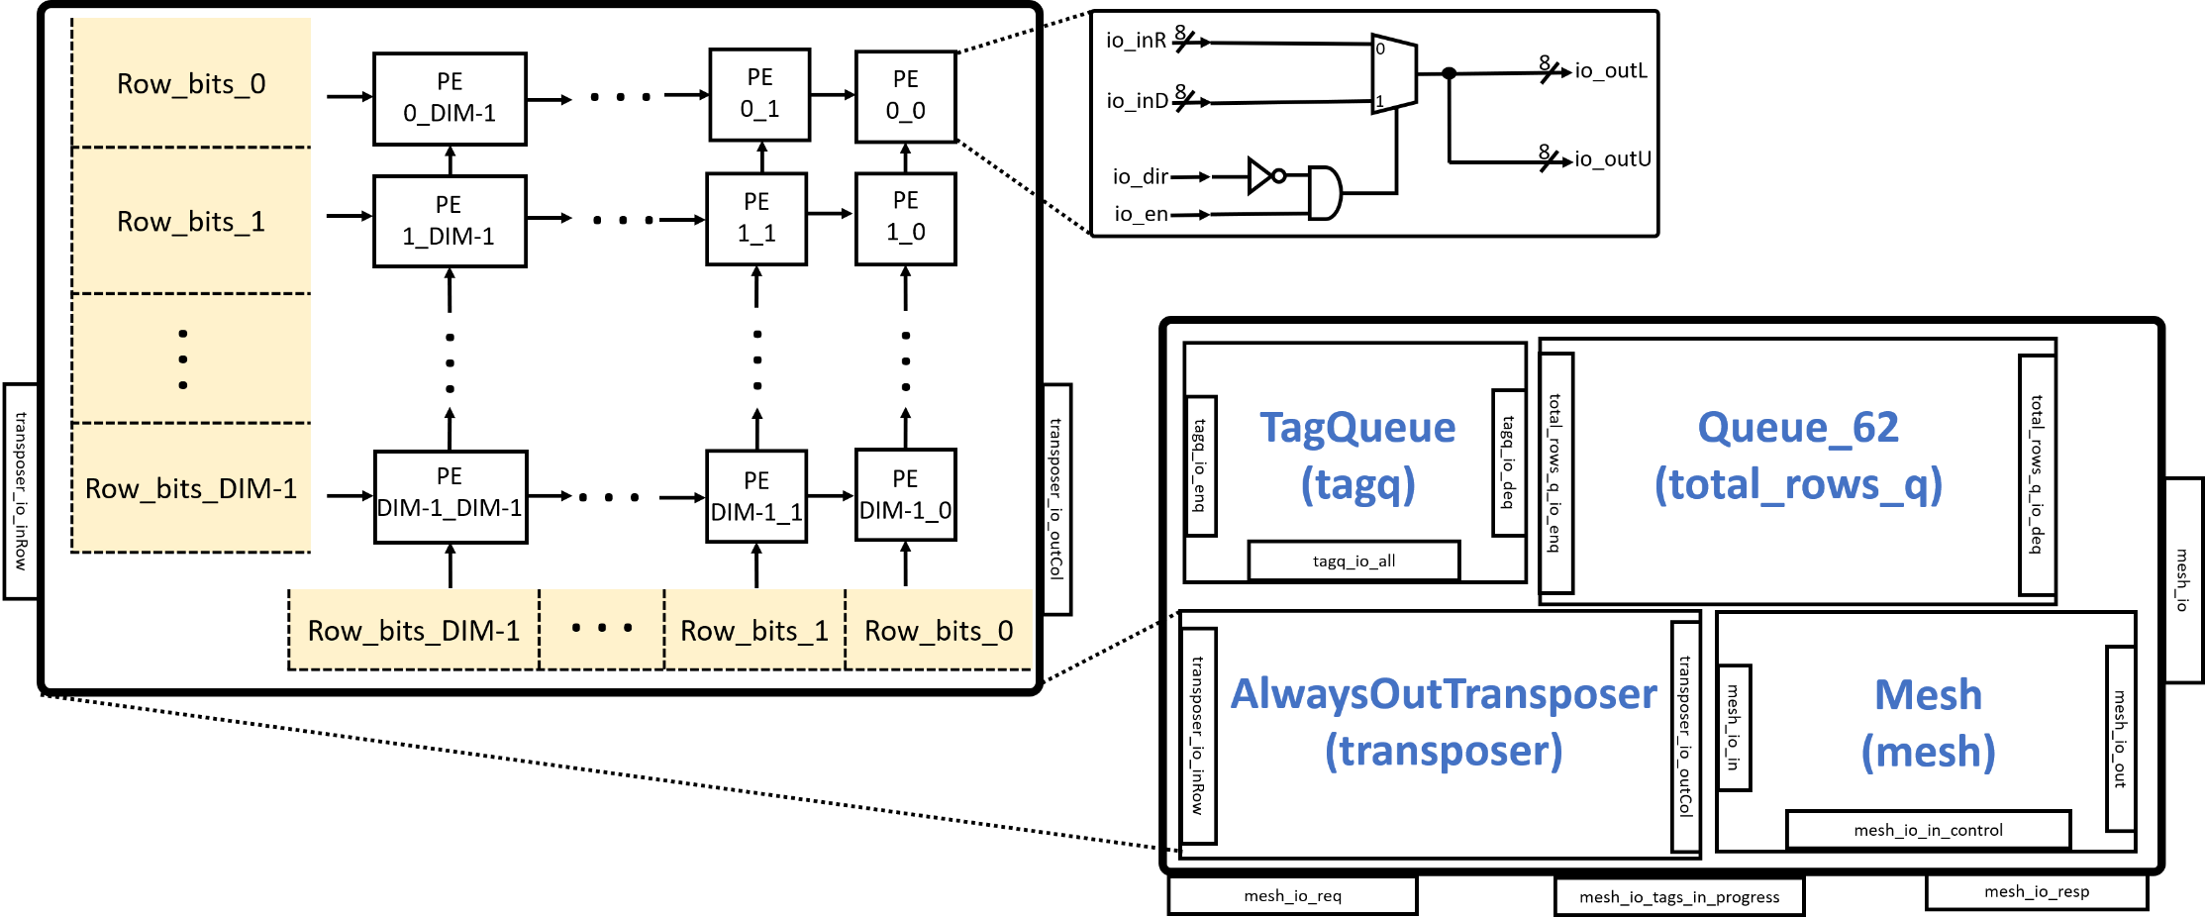
Gemmini Modules (MeshWithDelay)
The MeshWithDelays consists of modules such as the Mesh and AlwaysOutTransposer
The AlwaysOutTransposer is used to transpose a matrix before it enters the MeshWithDelays module
The AlwaysOutTransposer is implemented as a systolic array with configurable DIM×DIM PEs

Slide 41
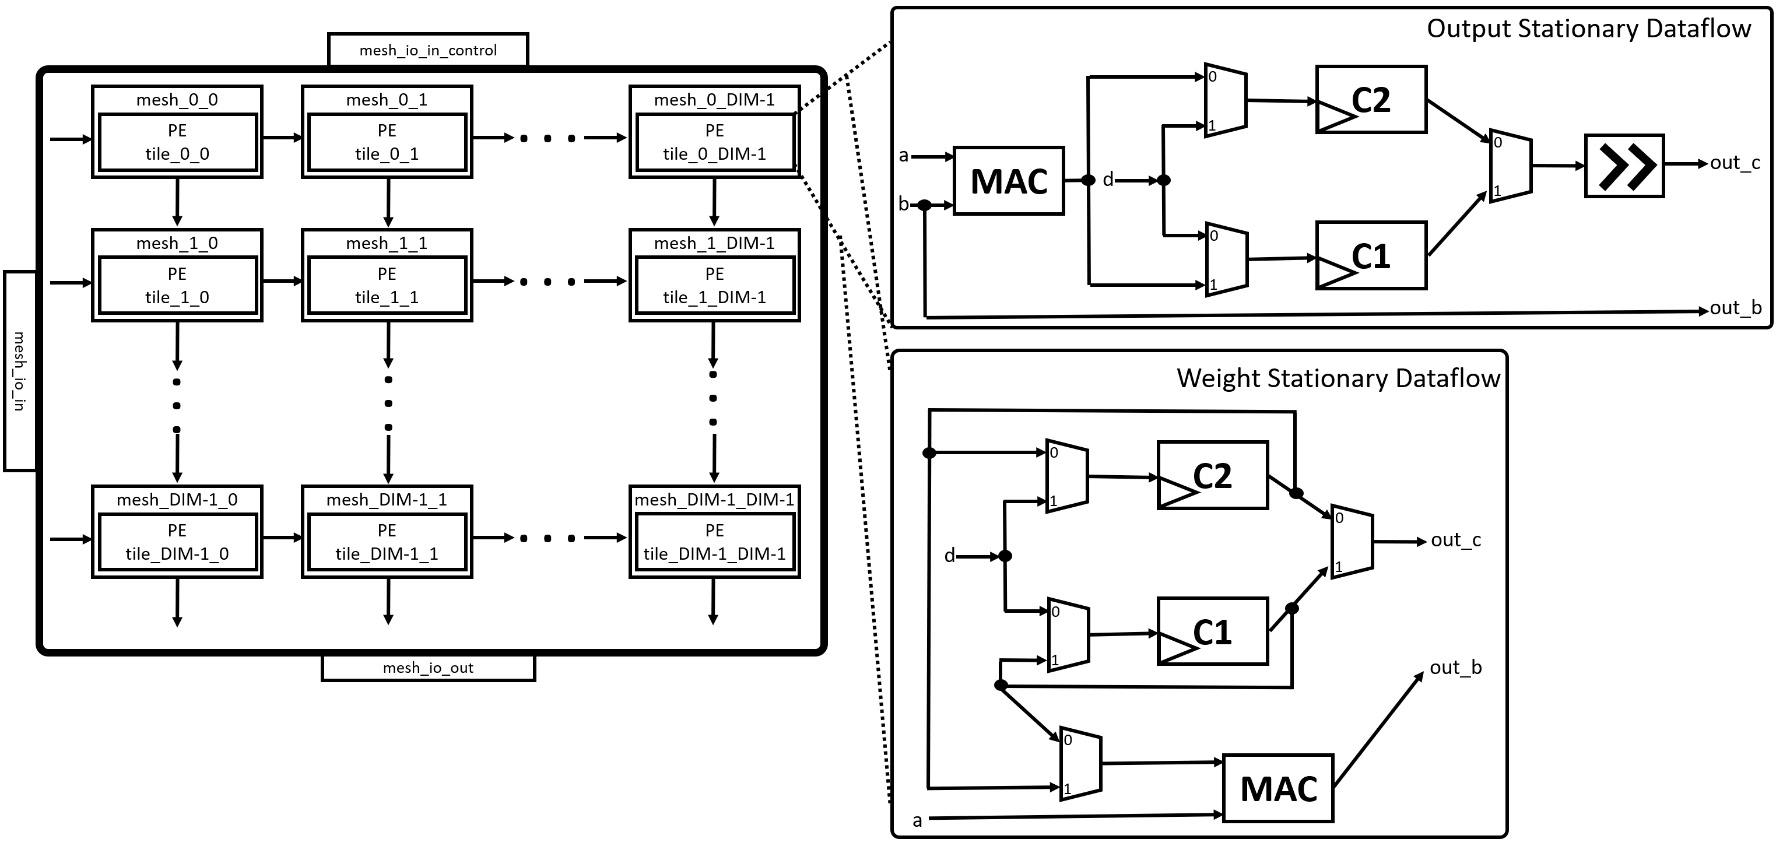
Gemmini Modules (Mesh)
The module implements the systolic array of the Gemmini accelerator with configurable mesh rows and mesh columns
There are delay registers at each mesh output to enable each input from one matrix to arrive at the same time as the input of another matrix before multiplication
The PEs can also be configured to employ different dataflows such as OS or WS or both as shown in the figure

Slide 42
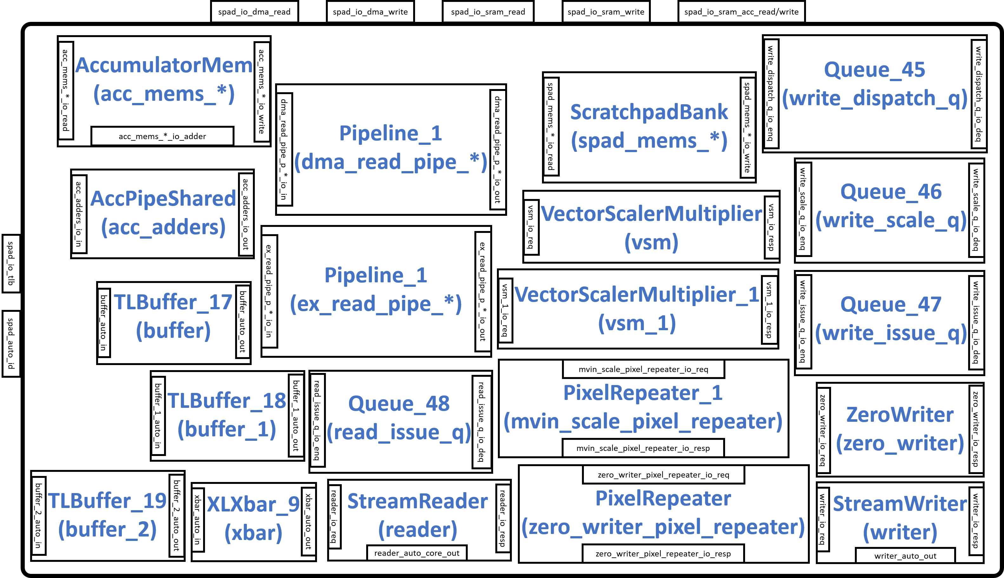
Gemmini Modules (Scratchpad)
The scratchpad module is responsible for storing data that is generated during the matrix multiplication or convolution operation
It consists of input/output (IO) interfaces including spad_io_tlb (connects to the FrontTLB module), spad_auto_id (connects to the L2cache/DRAM), spad_io_dma_read/write (connects to DMA), spad_io_sram_read/write (connects to the ScratchpadBank), and spad_io_acc_read/write (connects to the AccumulatorMem)

Slide 43
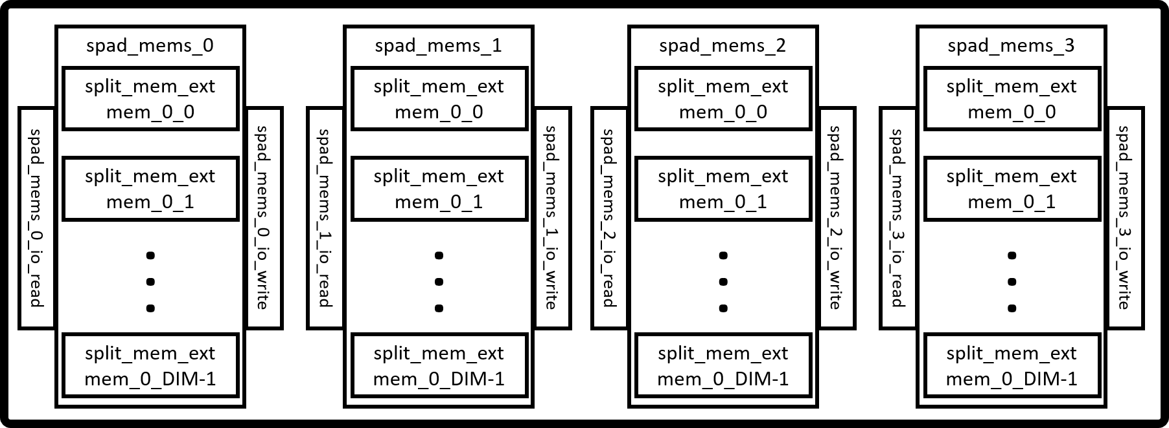
Gemmini Modules (ScratchpadBank)
The Figure shows the arrangement of the ScratchpadBank in the Scratchpad module which is made up of simple SRAMs
The number of banks is configurable but usually consists of four banks for storing matrices A, B, D, and C
Each bank has a default data width of 8 and a depth of DIM

Slide 44
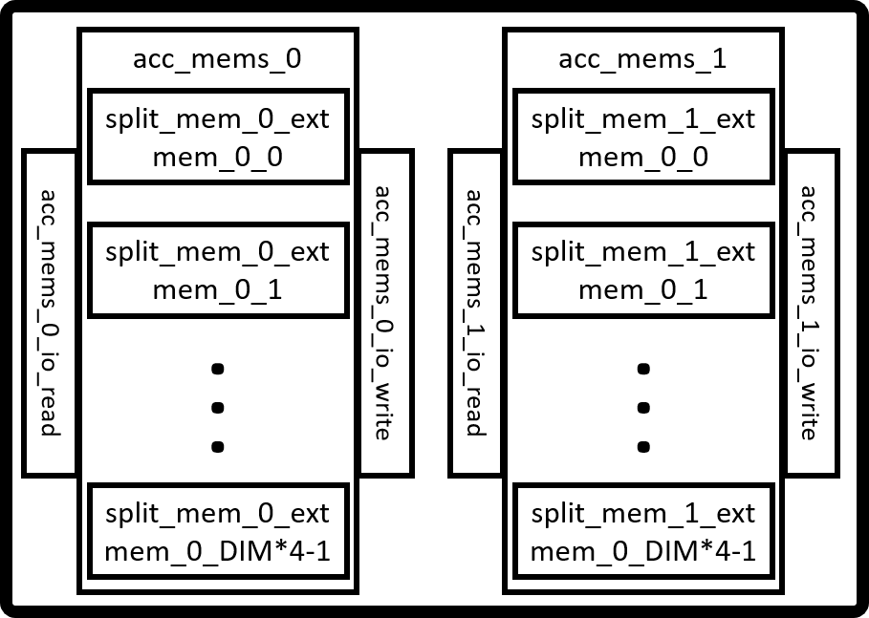
Gemmini Modules (AccumulatorMem)
The module is configurable but the default consists of two accumulators for storing the intermediate or final results of the matrix multiplication or convolution operation
The data width of each accumulator is a default value of 32 while the depth is DIM×4
In addition to the SRAMs, the accumulators have a set of adders located in the AccPipeShared of the scratchpad module
They also have an internal scaler for transforming the 32-bit data width into 8-bit data width

Slide 45
Software Code Compilation (GEMM)
The Gemmini hardware accelerator can be controlled in several ways
The control or programming of the Gemmini accelerator can be achieved at three different levels including:
High-level programming of compiling ONNX models
Mid-level programming using kernel libraries
Low-level programming using assembly or direct machine configuration
To investigate the performance of GEMM on various configurations of the Gemmini accelerator, this work selected the mid-level programming of the accelerator

Slide 46
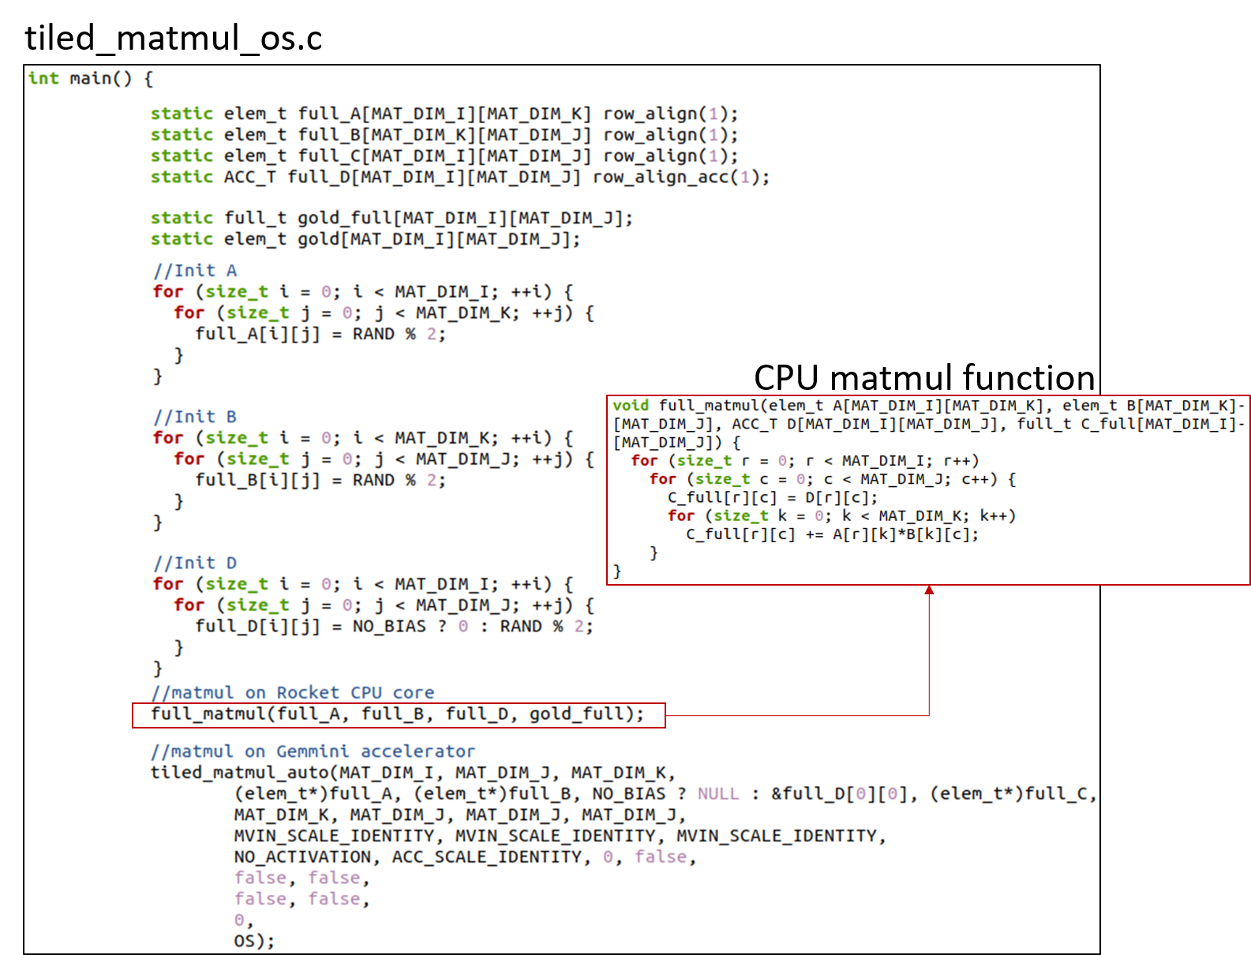
Software Code Compilation (GEMM)
This work compiles bare-metal matrix multiplication programs that can be executed in the Gemmini hardware or the Rocket CPU core
The programs include the tiled_matmul_os.c for the OS dataflow option and tiled_matmul_ws.c for the WS dataflow option
A section of the tiled_matmul_os.c file is shown in the Figure

Slide 47
Software Code Compilation (GEMM)
The program starts by initializing the matrices with random values before calling the full_matmul function for the execution of matrix multiplication on the Rocket CPU
The program then calls the tiled_matmul_auto function for the execution of matrix multiplication on the Gemmini accelerator
The tiled_matmul_auto function is located in the gemmini.h header file which was generated together with the Gemmini SoC Verilog files

Slide 48
Software Code Compilation (GEMM)
The tiled_matmul_auto function runs matrix multiplication of dimensions that are higher than the systolic array by automatically calculating the tiling factors
The function then calls the tiled_matmul function with hardcoded tiling parameters which subsequently calls the tiled_matmul_outer function

Slide 49
Software Code Compilation (GEMM)
The tiled_matmul_outer makes a series of configuration function calls including
gemmini_extended3_config_ld: for moving matrix A, B, and D from DRAM to the Scratchpad
gemmini_extended_config_st: for moving data from the Scratchpad to the DRAM
gemmini_extended_config_ex: for executing the matrix multiplication in the systolic array of the ExecuteController module

Slide 50
Software Code Compilation (GEMM)
Each of the configuration functions is arranged into the RoCCommand format and is transferred to the Gemmini accelerator through the RoCC interface

Slide 51
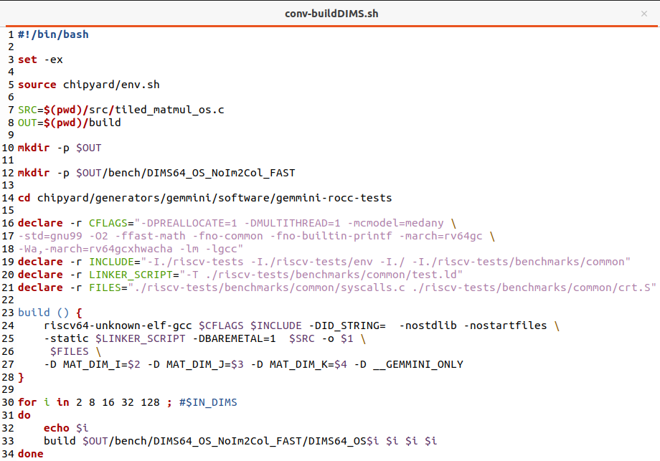
Software Code Compilation (GEMM)
The RISC-V compiler (riscv64-unknown-elf-gcc version) is used to compile the tile_matmul_os.c and tiled_matmul_ws.c programs together with a linker file that points to the base address of the instruction memory

Slide 52
Software Code Compilation (GEMM)
Executable (.exe) files are generated and converted to hexadecimal files (.hex) tiled_matmul_os.hex and tiled_matmul_ws.hex using the SiFive elf2hex program
The Verilator simulator loads the hexadecimal files into the designated location of the DRAM simulation module which prompts the Rocket CPU to begin executing instruc-tions starting from the base address
The simulator reports the performance of executing the matrix operations on both the Rocket CPU core and the Gemmini accelerators for comparison

Slide 53

Gemmini 2x2 Matrix Multiplication Cycles
Performance Gemmini speedup relative to Rocket CPU
Above 1 mean speedup and below 1 means slowdown

Slide 54

Gemmini 8x8 Matrix Multiplication Cycles
Performance Gemmini speedup relative to Rocket CPU
Above 1 mean speedup and below 1 means slowdown

Slide 55

Gemmini 16x16 Matrix Multiplication Cycles
Performance Gemmini speedup relative to Rocket CPU
Above 1 mean speedup and below 1 means slowdown

Slide 56

Gemmini 32x32 Matrix Multiplication Cycles
Performance Gemmini speedup relative to Rocket CPU
Above 1 mean speedup and below 1 means slowdown

Slide 57

Gemmini 128x128 Matrix Multiplication Cycles
Performance Gemmini speedup relative to Rocket CPU
Above 1 mean speedup and below 1 means slowdown

Slide 58
Gemmini RTL Synthesis
The Verilog files of the Gemmini accelerators are synthesized using the commercial tool Vivado v2020.2
Four Gemmini accelerators are generated based on the systolic array size which includes 8 × 8, 16 × 16, 32 × 32, and 64 × 64 for comparison
Each of the accelerators has an option for including an im2col module or not
This work synthesized each of the Gemmini accelerators using the Virtex UltraScale+ XCVU19P-FSVA3824-1-E FPGA device
The synthesis report of each Gemmini accelerator produced the resources occupied, the maximum frequency, and the power consumption

Slide 59
Gemmini RTL Synthesis
Gemmini hardware resource consumption

Slide 60

Gemmini RTL Synthesis
Gemmini modules CLB LUT usage

Slide 61
Gemmini Performance-Per-Area Analysis
The performance-per-area metric estimates the performance in terms of the execution time of various matrix dimensions on the generated Gemmini hardware architectures
It also estimates how each dataflow option makes use of the available hardware resources
The metric for a particular Gemmini accelerator is calculated as the ratio of the total speedup of the accelerator and the total number of CLB LUTs consumed
The speedup of a Gemmini accelerator is the ratio of the total execution time of all the GEMM operations on the accelerator and the Rocket CPU core

Slide 62

Gemmini Performance-Per-Area Analysis
The Figure illustrates the performance-per-area of each Gemmini configuration as well as the performance speedups relative to the Rocket CPU

